Slide 1

Accessing MIDFIELD: A Workshop for R beginners
FIE 2019
Wednesday October 16, 2019 5 – 8 pm

Slide 2
Workshop Agenda
Min | Topic
10 | Introductions and Objectives
5 | The data structures in MIDFIELD and midfieldr
30 | Finding stories in the data
35 | Starting with R (tutorial)
15 | — break —
20 | Elements of effective graphs
5 | Introduce midfieldr
50 | Starting with midfieldr (tutorial)
10 | Next steps

Slide 3
Facilitators
Matthew Ohland, MIDFIELD Director/PI
Associate Head and Professor of Engineering Education, Purdue
Russell Long, MIDFIELD Managing Director
Richard Layton, MIDFIELD Data Display Specialist
Professor of ME, Rose-Hulman
Marisa Orr, MIDFIELD Associate Director
Assistant Professor of Mechanical Engr/ Engr & Science Ed, Clemson
Susan Lord, MIDFIELD Institute Director
Professor and Chair of Integrated Engineering, University of San Diego

Slide 4
Facilitators
Hasan Al Yagoub, Graduate Research Assistant, Engineering Education, Purdue
Hossein Ebrahiminejad, Graduate Research Assistant, Engineering Education, Purdue

Slide 5
Workshop Objectives
By the end of this workshop, participants should be able to
Describe key variables in the MIDFIELD data
Select academic programs and populations to study
Use midfieldr, an R package specifically designed for use with MIDFIELD, to compute persistence metrics
Explore and tell a story from MIDFIELD data Explain key features of effective data displays
Notes:
These were the objectives listed in the FIE19 paper
Describe key variables in the MIDFIELD data
Select academic programs and populations to study
Compute persistence metrics
Graph persistence metrics
Explain key features of effective data displays

Slide 6
Workshop Objectives
From SML: note changes
By the end of this workshop, participants should be able to
Describe key variables in the MIDFIELD data
Select academic programs and populations to study CUT?
Use midfieldr, an R package specifically designed for use with MIDFIELD, to compute persistence metrics I ADDED PART IN RED
Explore and tell a story from MIDFIELD data I ADDED THIS. OK?
Graph persistence metrics CUT?
Explain key features of effective data displays
Notes:
These were the objectives listed in the FIE19 paper
Describe key variables in the MIDFIELD data
Select academic programs and populations to study
Compute persistence metrics
Graph persistence metrics
Explain key features of effective data displays

Slide 7
Introduction to MIDFIELD

Slide 8
M ultiple
I nstitution
D atabase
F or
I nvestigating
E ngineering
L ongitudinal
D evelopment
Whole-population data for institutions and time period
Current dataset
22 institutions
1.5 million unique students in all departments
250,000 unique engineering students, approximately 1/7 US engineering enrollment
5-year expansion plan in progress
Total of 100+ diverse institutions
1/2 US engineering enrollment
Notes:
1:32 2 min
Marisa – need to check updated numbers
Approximately 1/9 of US engineering enrollment
Student records for all undergraduate degree-seeking students from 1988-2011 at 11 institutions, including two HBCUs. Update in progress and other institutions are in various stages of joining the partnership.
Predominantly southeastern, higher proportion (20%) of engineering students than other institutions offering engineering (10%)
Over 1 million unique students over a 20-year period including over 200,000 engineering students, likely typical of large publics, can disaggregate by race/gender
Policy information available through catalogs, web archives, and consultation with partners

Slide 9
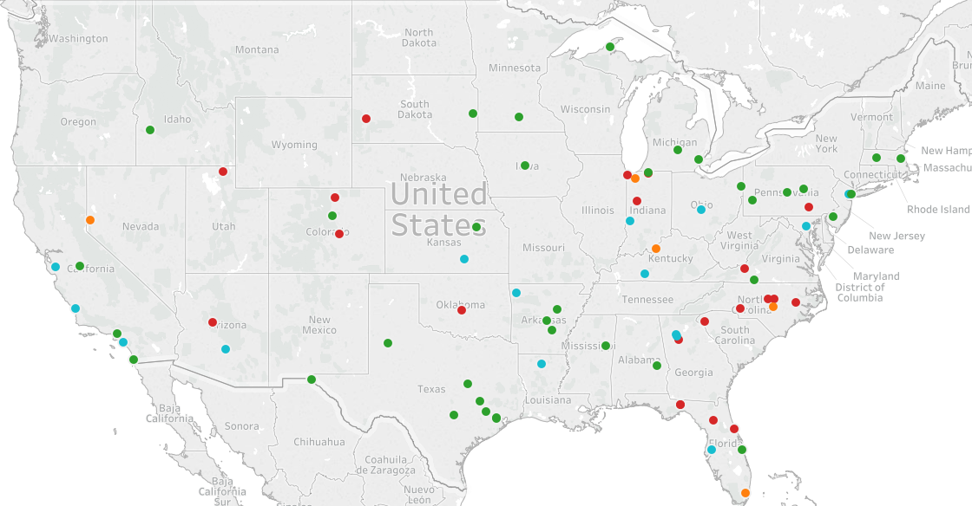

Institutions in negotiations to join MIDFIELD

Slide 10
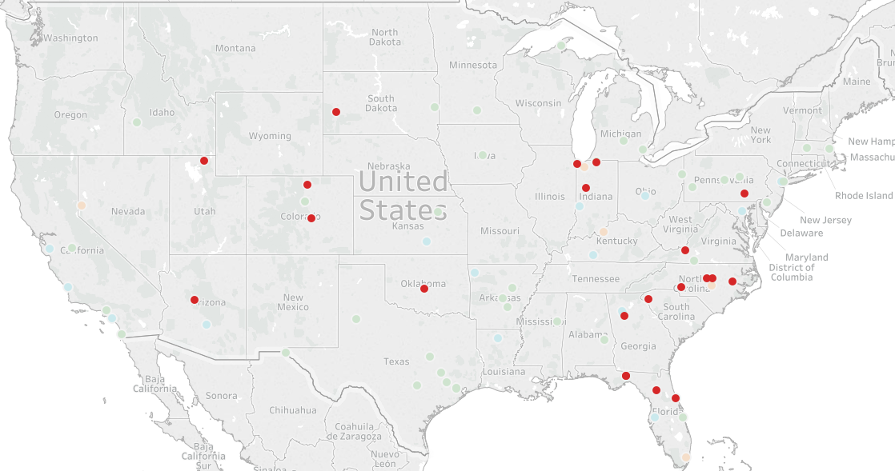
Institutions that have already provided data to MIDFIELD

Slide 11
Different uses of MIDFIELD
Demographic data:
Who enrolls? Where are they coming from?
Graduation data:
Who graduates? How long does it take?
Term data:
When do students leave? How do students move among majors? Why do students change majors and what happens?
Course data:
How do grade distributions vary by section? To what extent do students intentionally co-enroll in classes?
Notes:
1:37 2 min
Only degree-seeking students – not HS, dual enrollment, post bac, etc.

Slide 12

What have MIDFIELD researchers accomplished?
Many publications in journals and conference proceedings, conference presentations, multiple book chapters, and one entire book.
4 journal best paper awards, two conference best paper awards, and other recognitions (e.g. WEPAN, ECEDHA).
Panel discussions, invited workshops and talks, keynote addresses, publicity in various media outlets.
Notes:
ONLY DO NEXT SLIDES IF TIME PERMITS!

Slide 13
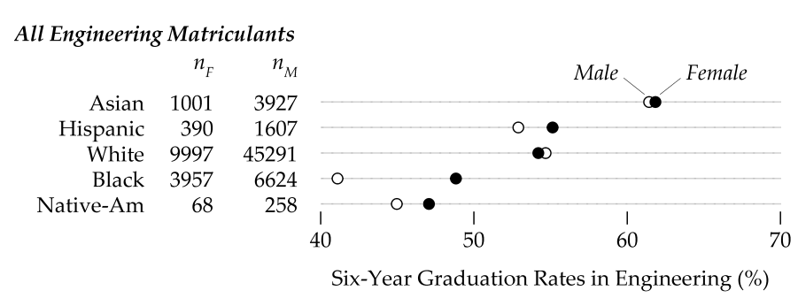
Women in graduate at the same rates as men.

Slide 14
Eight-semester persistence is a good predictor of six-year graduation… but not for everyone.

Slide 15
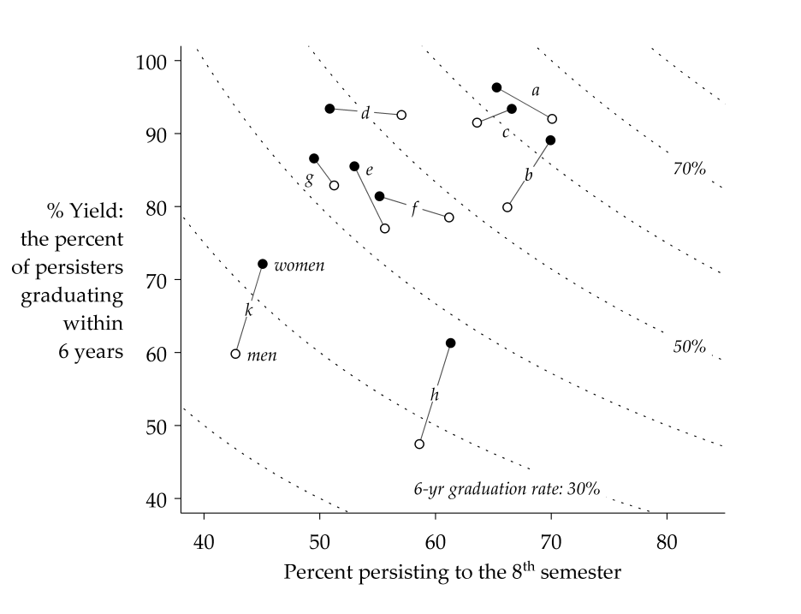
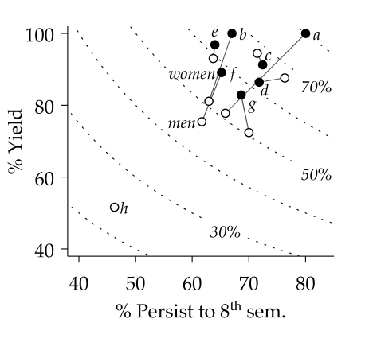
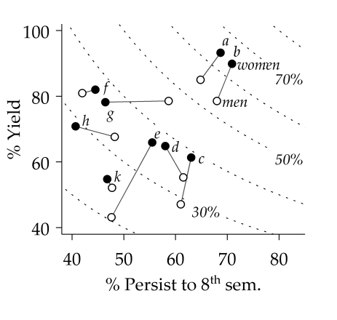
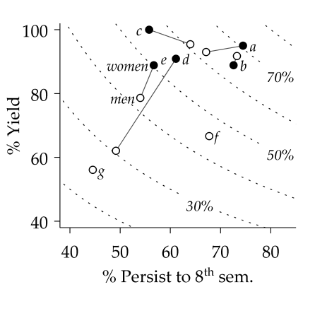
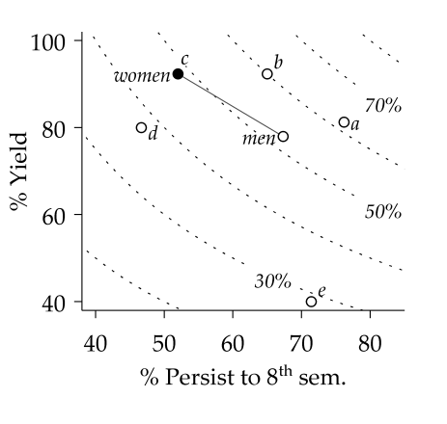
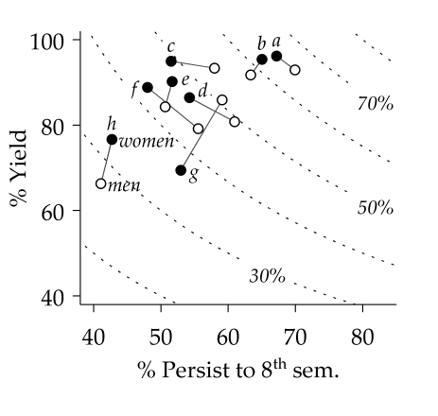
The aggregate experience doesn’t represent the experience of any racial/ethnic group.
Asian
Black
Hispanic
Native American
White

Slide 16
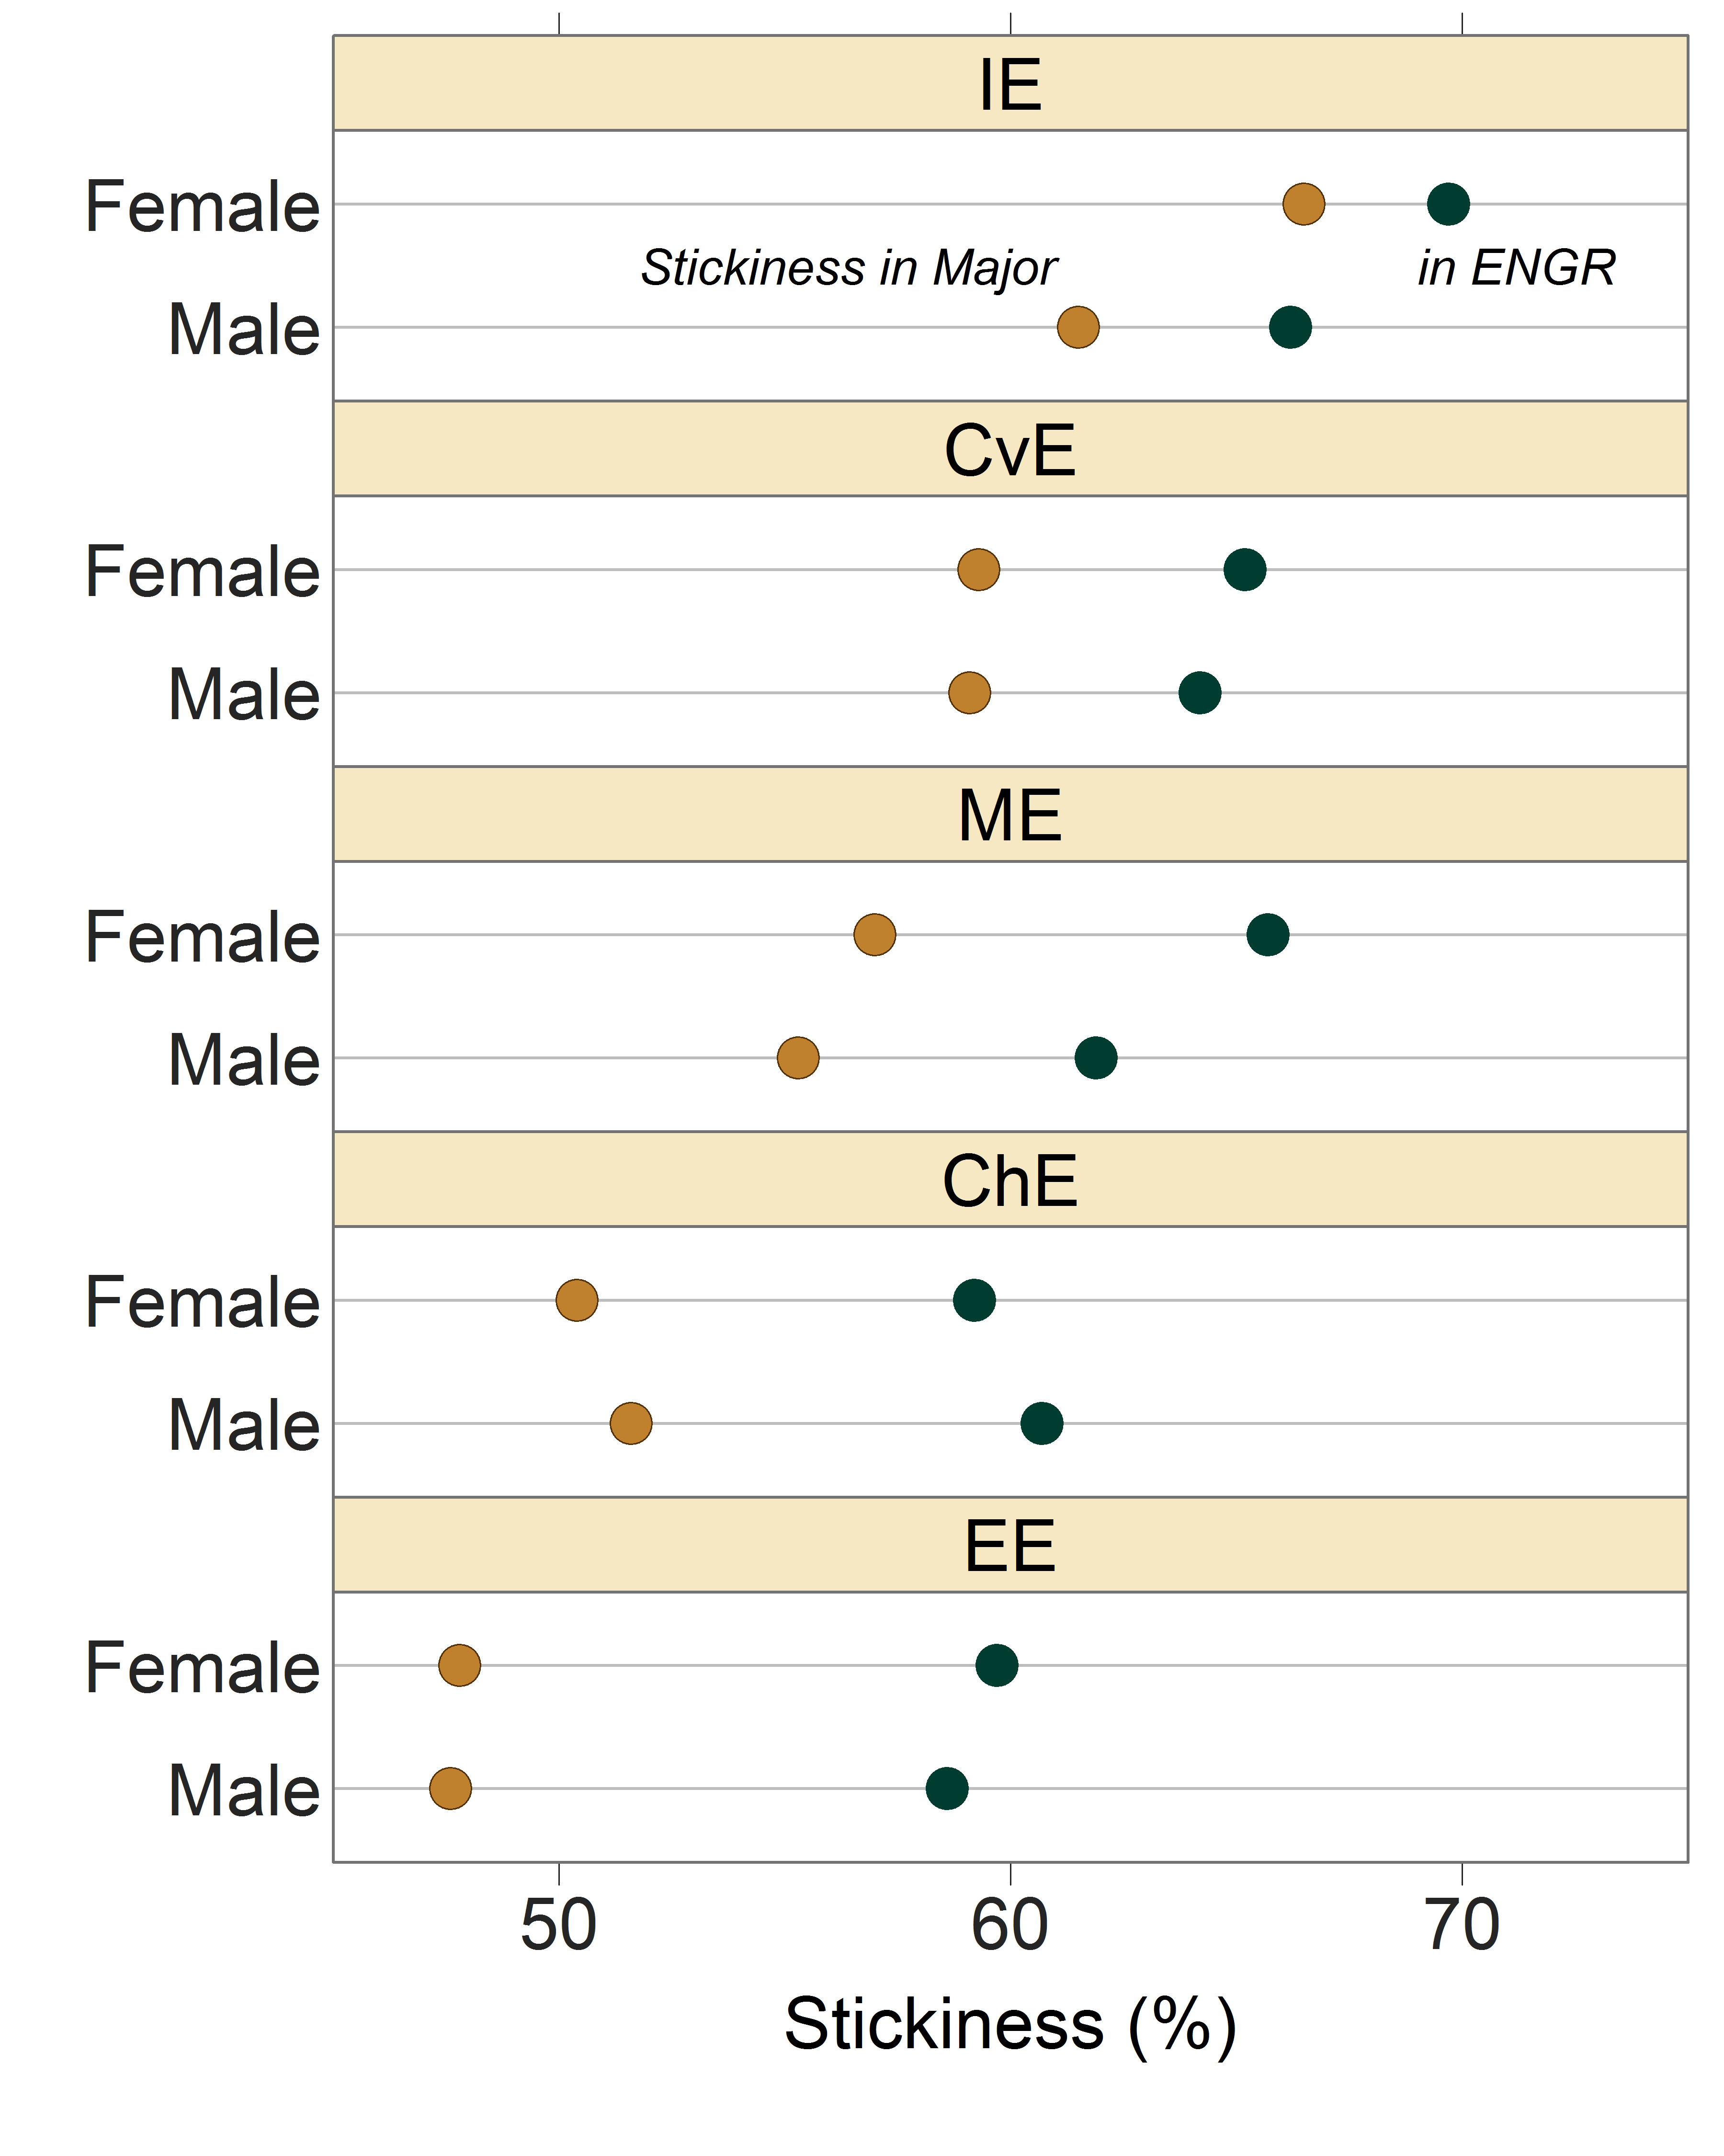
Some disciplines are better than others at graduating students… but some of the students who leave will graduate in other engineering majors.

